Slide 1
Predict and map wheat production across the SK, based on a 1938–2021 database using an unsupervised machine learning clustering approach.
Viraj Hewage

Slide 2
introduction
The crops, lands, and timing of 622 rural municipalities in Saskatchewan were used in a historical data analysis. Python and Geopanda used unsupervised machine learning clustering to analyze this large cohort.

Slide 3
Data Bases
rm_crop_yields_1938_2021.csv
Rural Mnicipilaty.shp

Slide 4
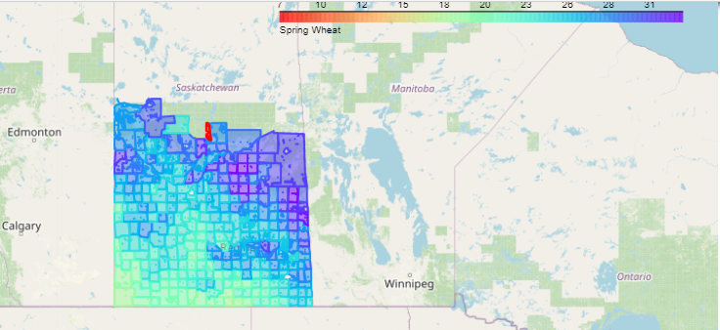
data Analysis
Why I chose Spring wheat data?

Slide 5
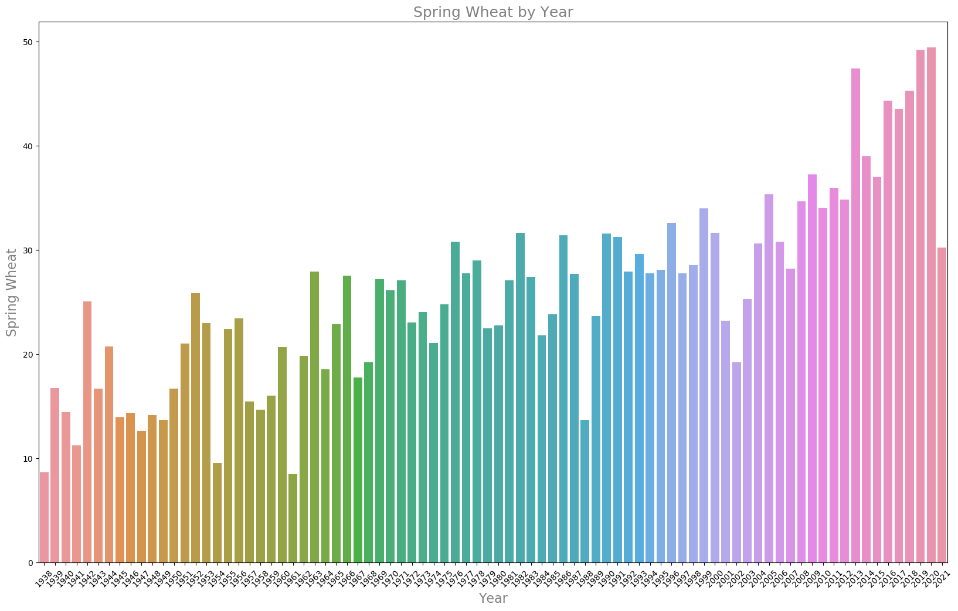
wheat production across the SK, based on a 1938–2021 database

Slide 6
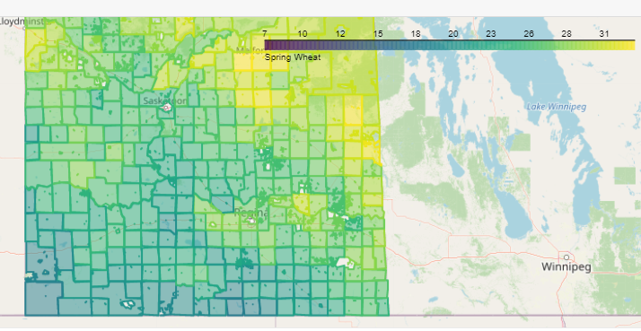
methodology
Generating Summary Statistics: Use the describe() method to generate summary statistics such as mean, standard deviation, quartiles, etc. Data were analyzed using the K-Means Clustering method as a technique for performing data groupings. Furthermore, the data classification procedure was based on the degree of each component’s membership. This analysis was performed by using python (pandas, numpy, matplotlib, seaborn) and Geopandas.

Slide 7
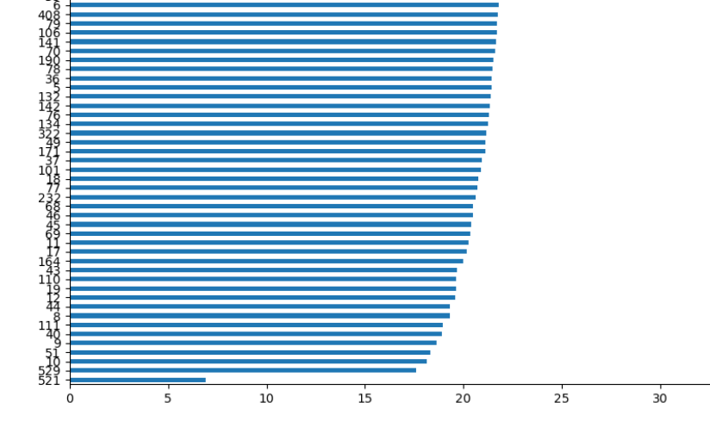
Finding A RM FoR Modeling

Slide 8

Time Series Forecasting RM 111 maple CREEK

Slide 9
DATA MODELING for RM 111, maple CREEK
Unsupervised machine learning algorithms are also useful for understanding the relationships between different variables in a dataset. For example, you can use clustering algorithms such as K-Means to identify clusters of similar points in a dataset
Define the features to be used for clustering

Slide 10
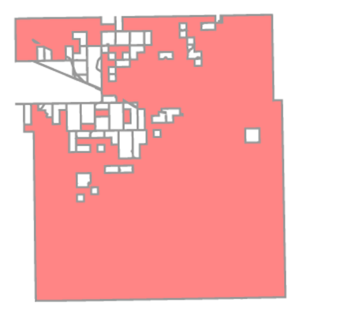
Create A Model for Spring-Weat in RM 111 maple CREEK

Slide 11
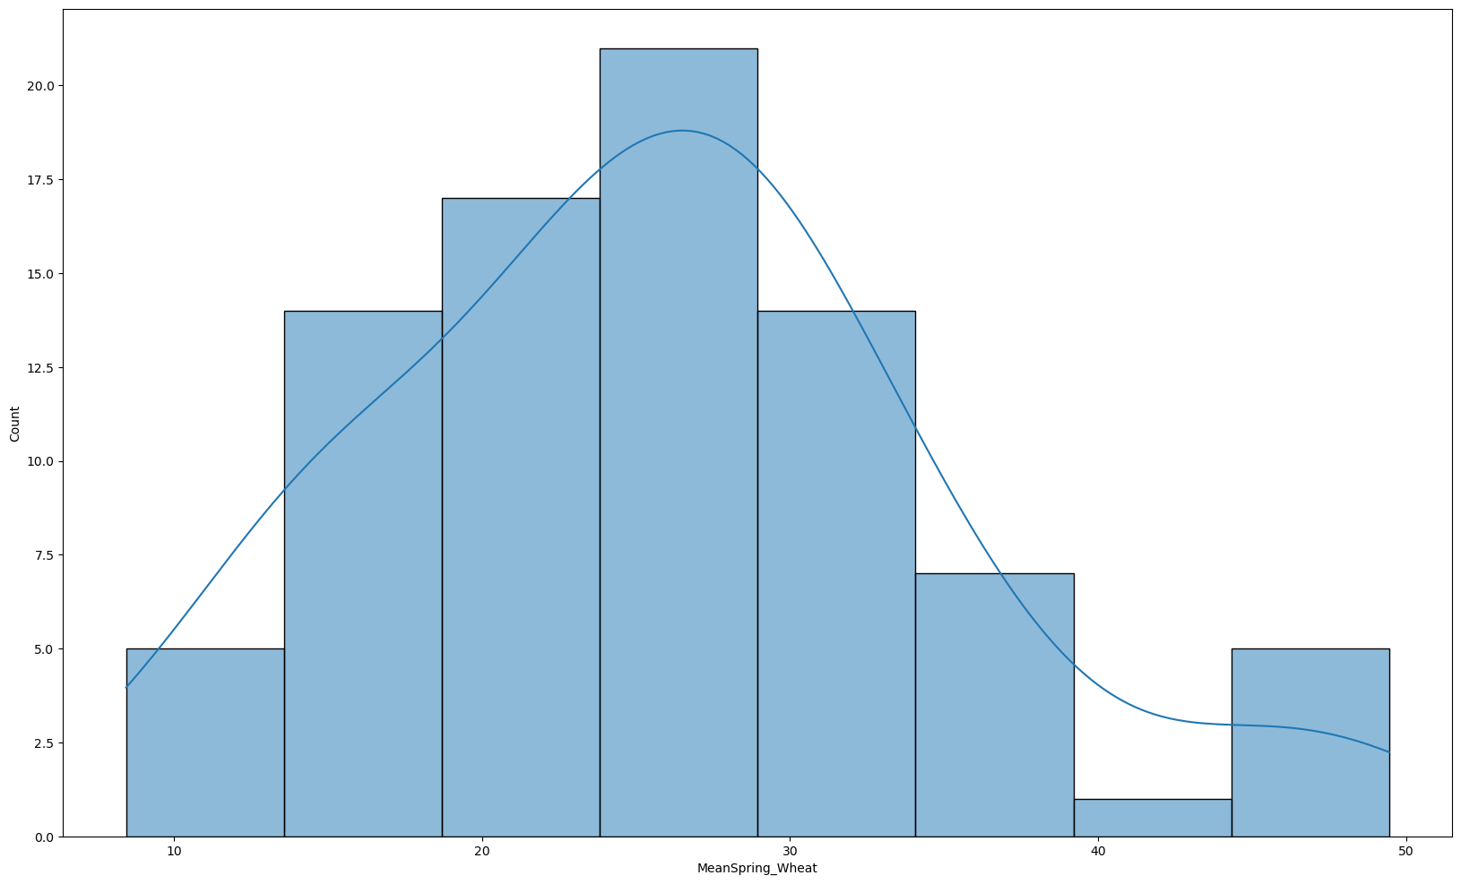
DATA MODELING for SK 622 RMs -Histogram
Shape (84, 6)
slope: 0.3097599939120827 intercept: -587.316443382177 r: 0.8226524204739321
p: 8.255635700786158e-22 stderr: 0.023641040235293034

Slide 12
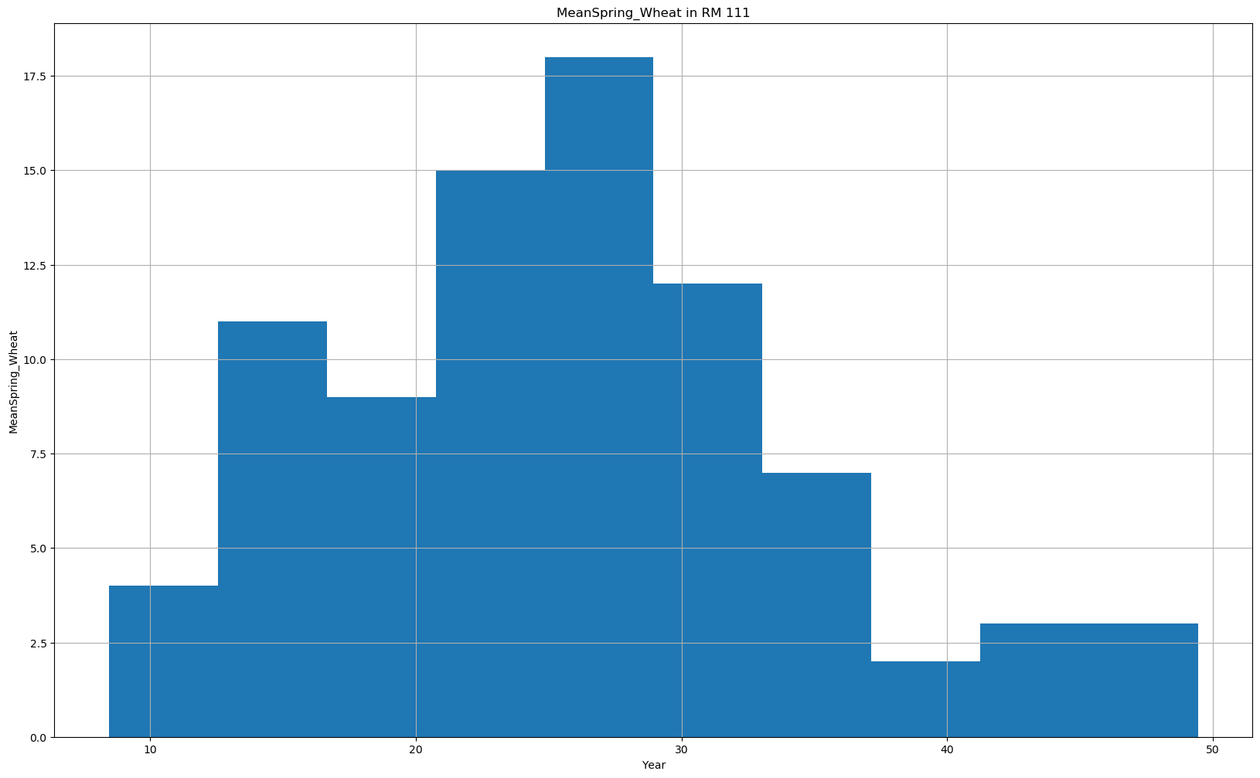
DATA MODELING for SK 622 RMs – BY Year

Slide 13
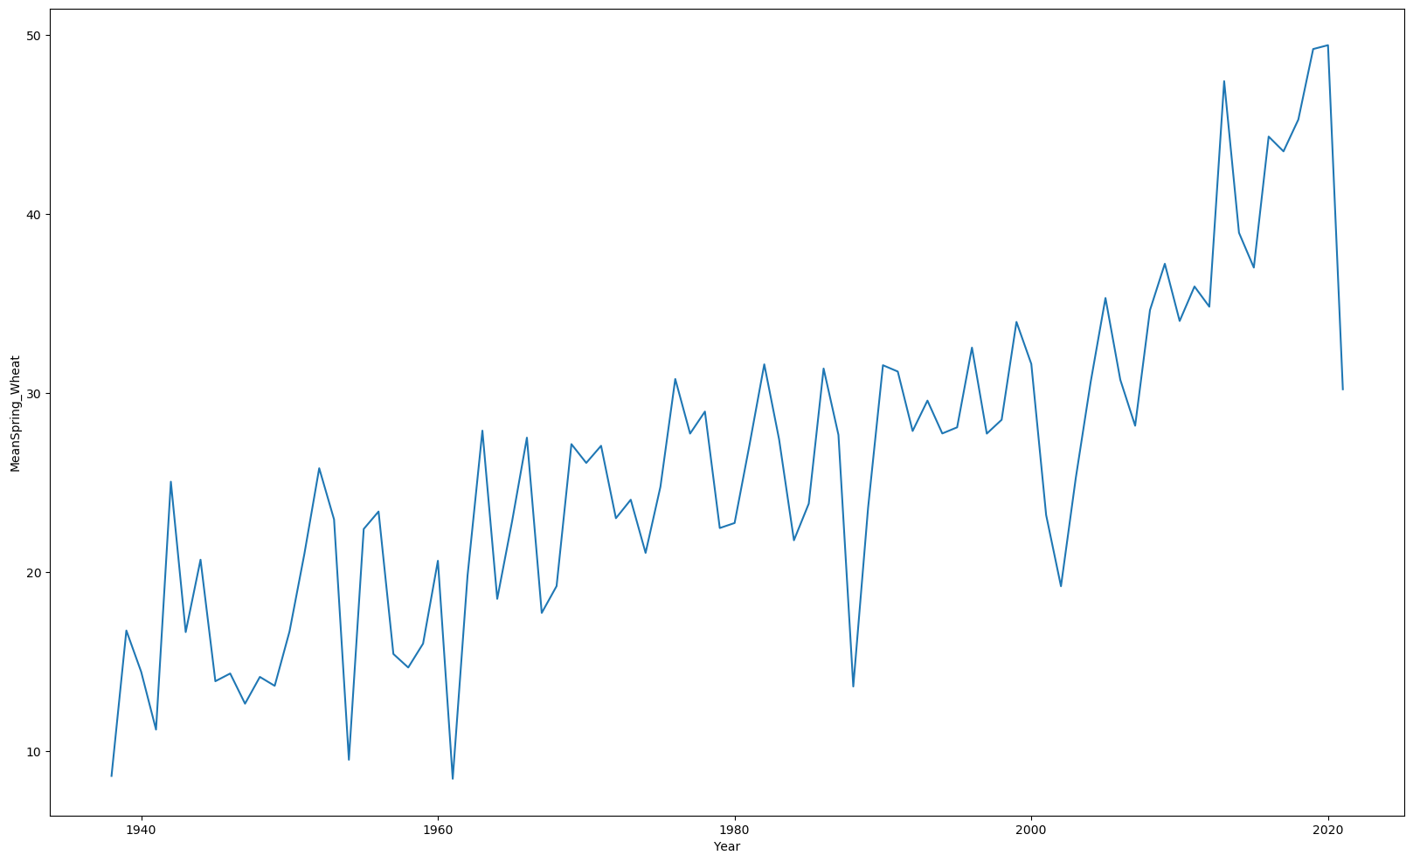
Time Series Forecasting RM 111 maple CREEK
Autoregressive Integrated Moving Average (ARIMA) models facilitate demand forecasting, such as in determining future demand for spring_weats. That is because the model provides products related to time. This forecasting can also be used to predict future yield production.

Slide 14
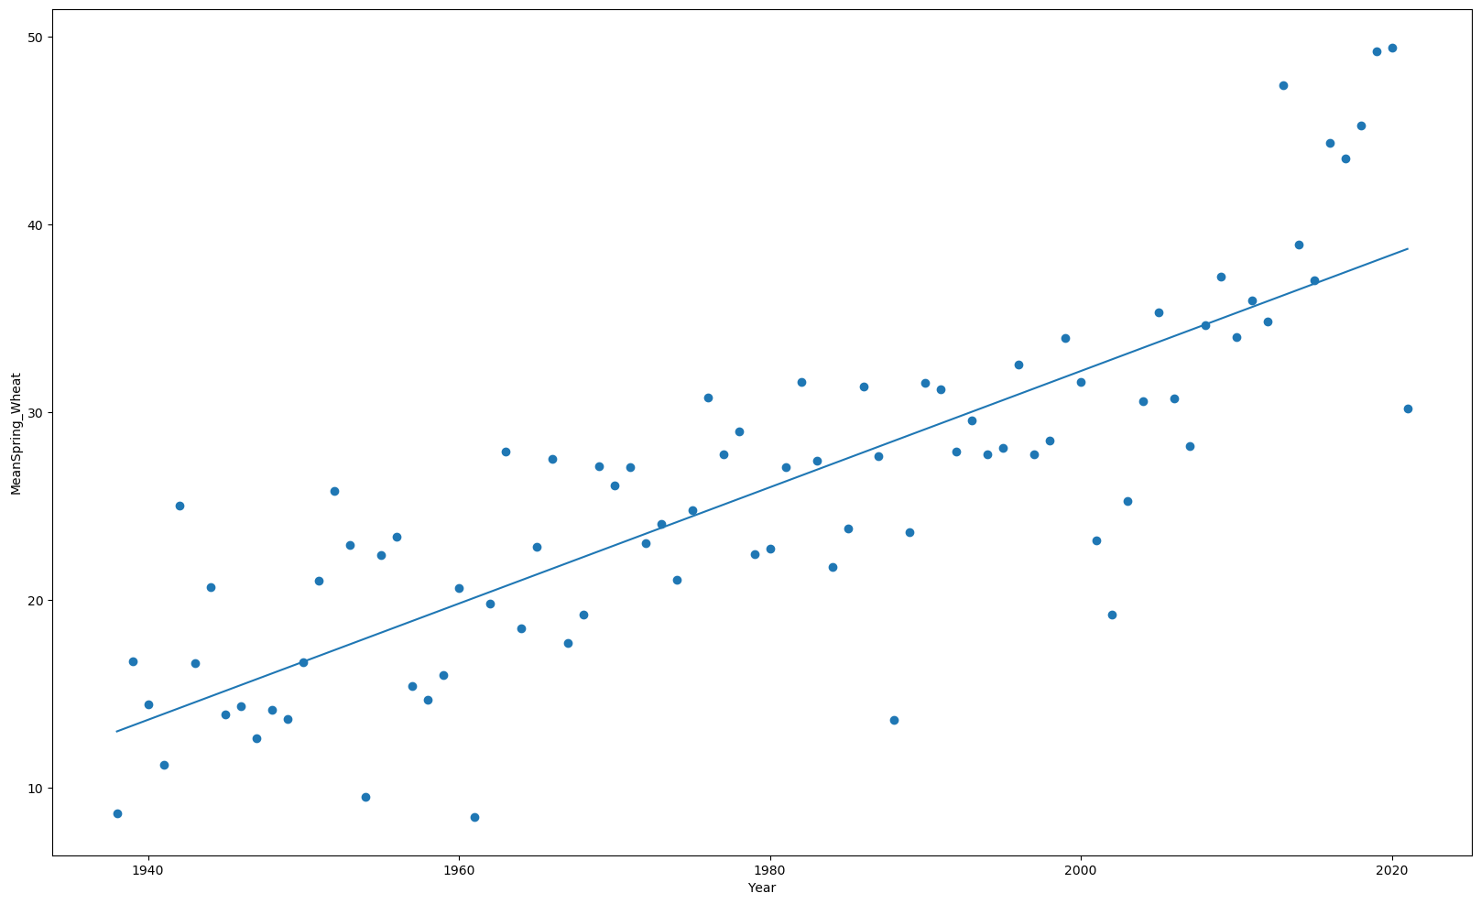
Linear regression forecasting for Spring_weat in RM 111, maple CREEK
We can see that there is a positive linear relationship between amount of mean spring_weat production and time.
With this model, we can predict production increases with the time.

Slide 15
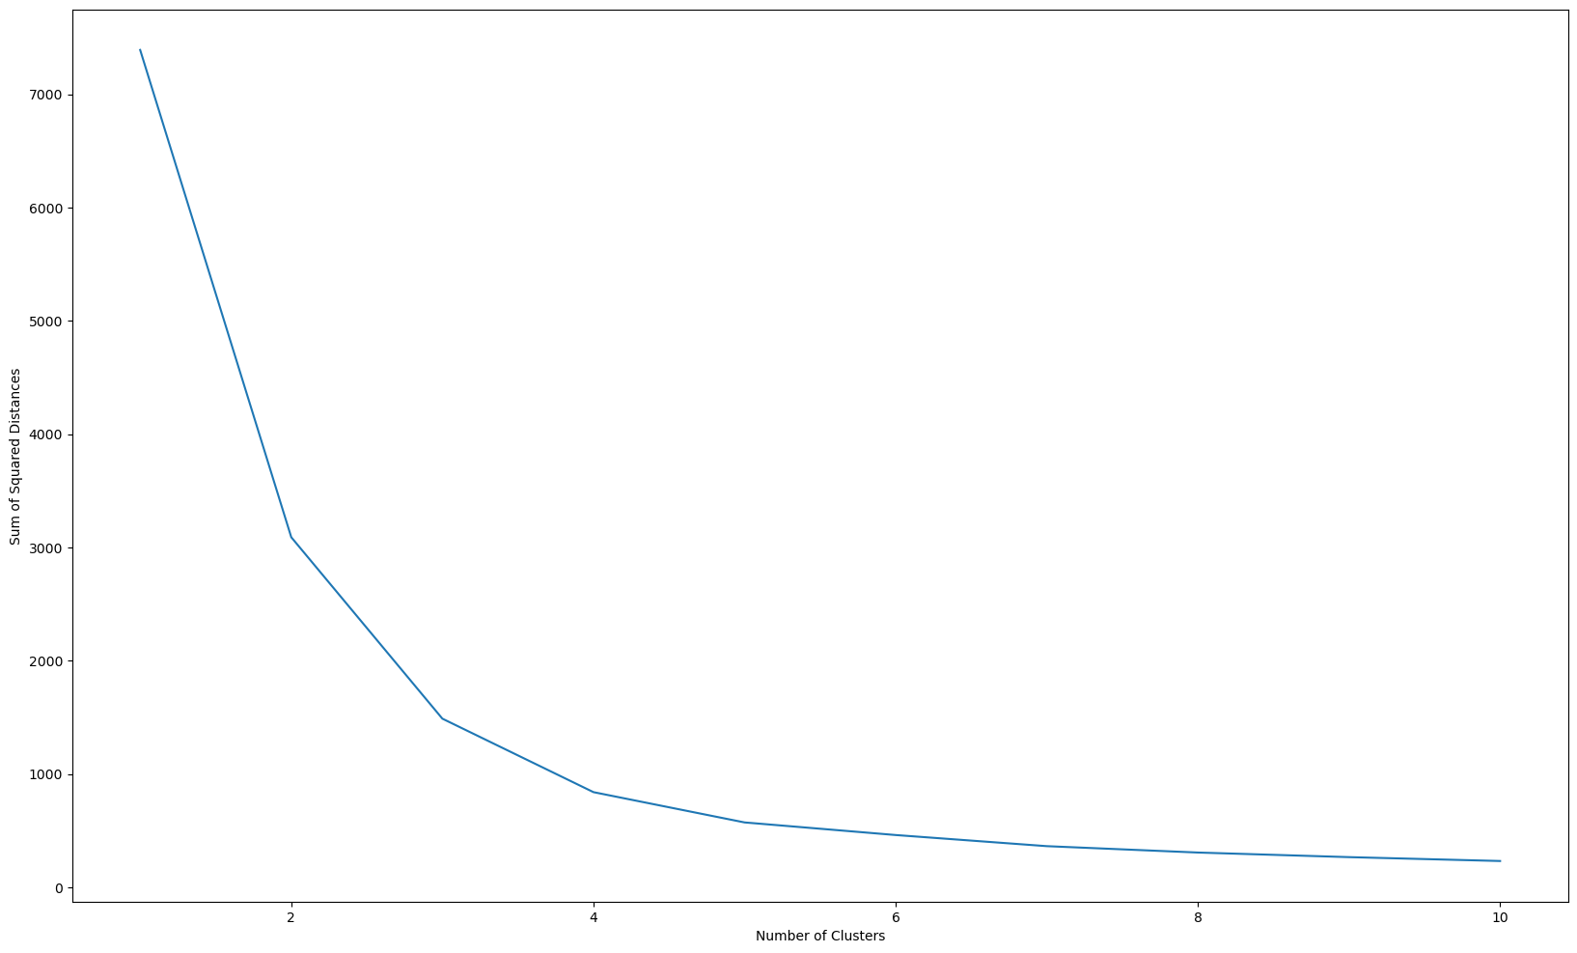
k-means clustering with scikit-learn
From the chart, it’s clear that the “elbow” is somewhere around the k value of 4. So, let’s run k-means with 4 clusters.

Slide 16
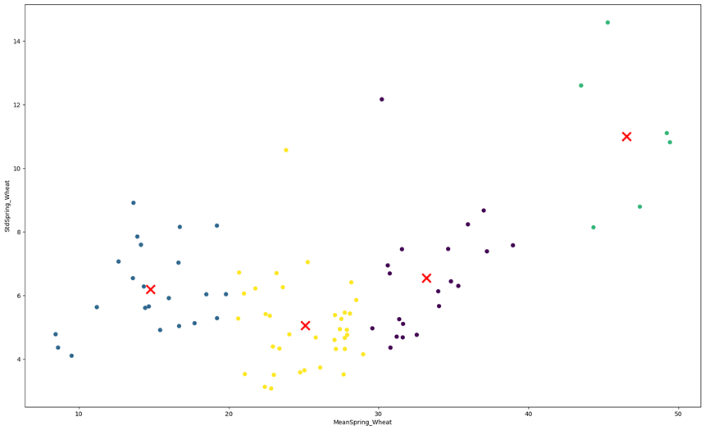
K-Means Clusters for Spring_weat in RM 111, maple CREEK

Slide 17
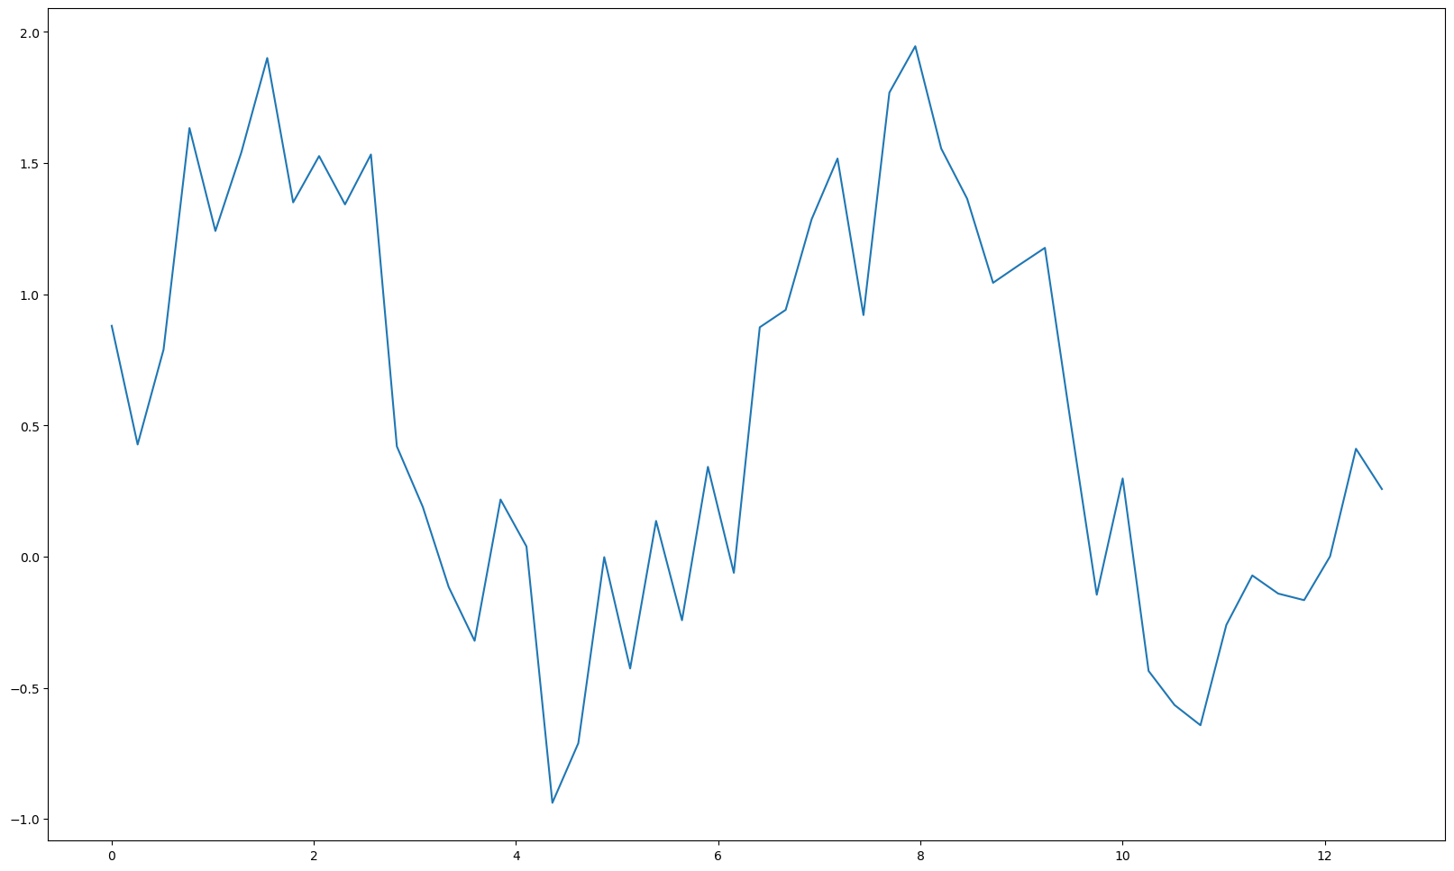
TO FIND MEA generate data added with noise

Slide 18
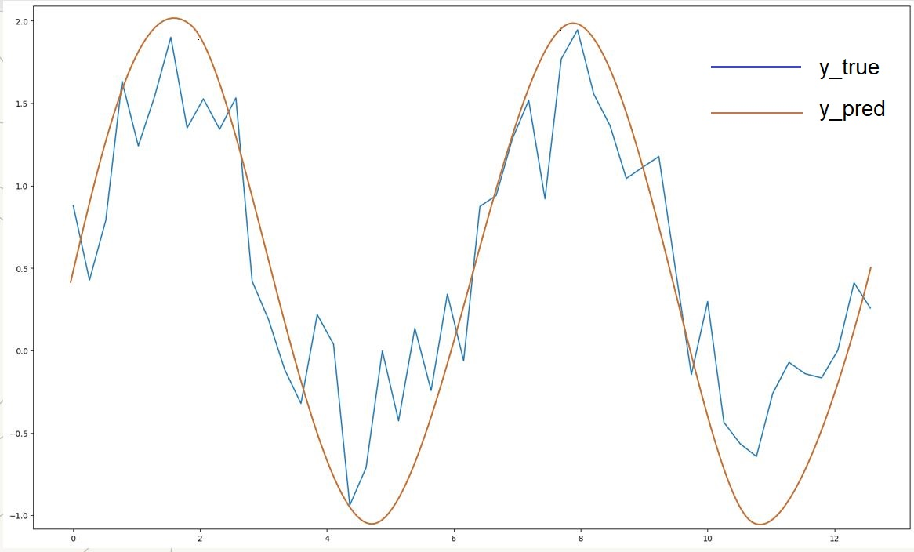
assume that we have made a model to predict the y values for each x in our dataset. Sinusoidal data with noise + prediction
The model output with data
The mean absolute error is: 0.48

Slide 19
DATA MODELING for SK 622 RMs

Slide 20
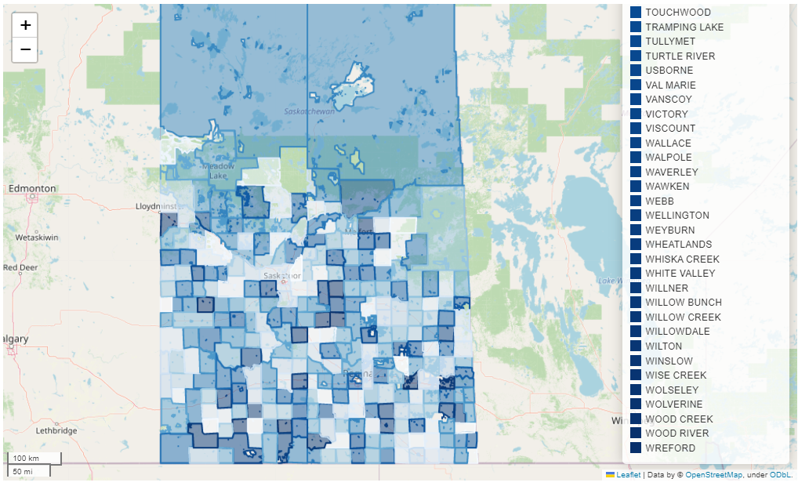

Slide 21
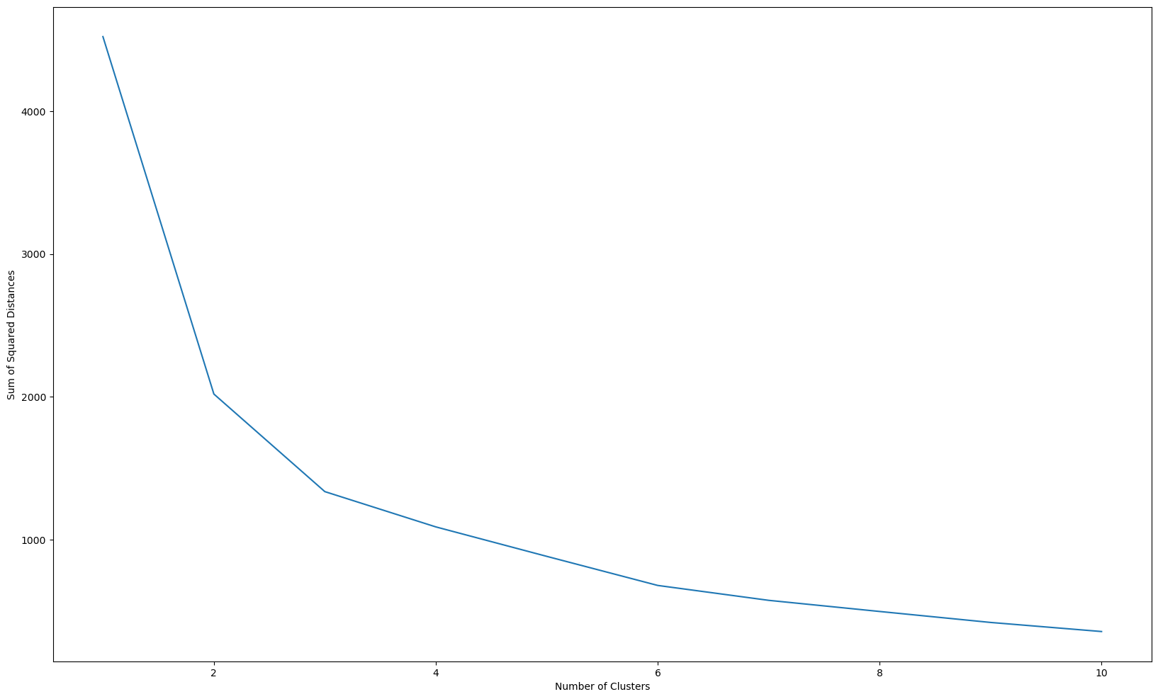
k-means clustering with scikit-learn
Found the “ Elbow”

Slide 22
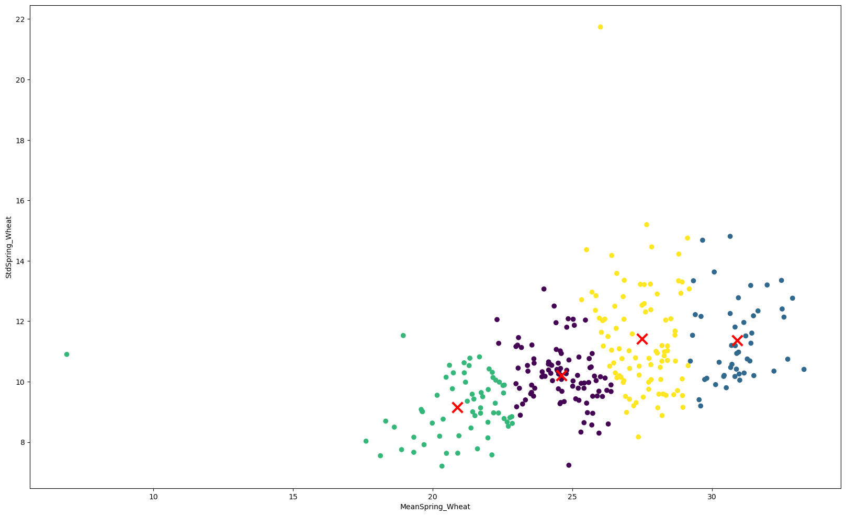
K-Means Clusters in Spring_weat FORSK 622 RMs

Slide 23
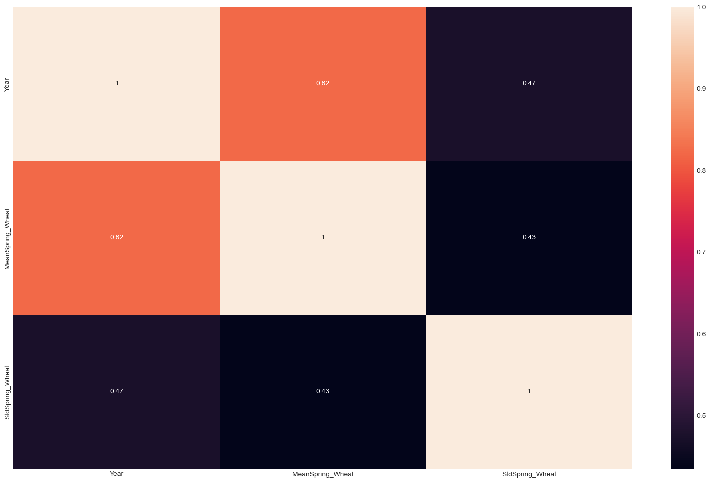
Heatmap for Spring_weat in for SK 622 RMs

Slide 24
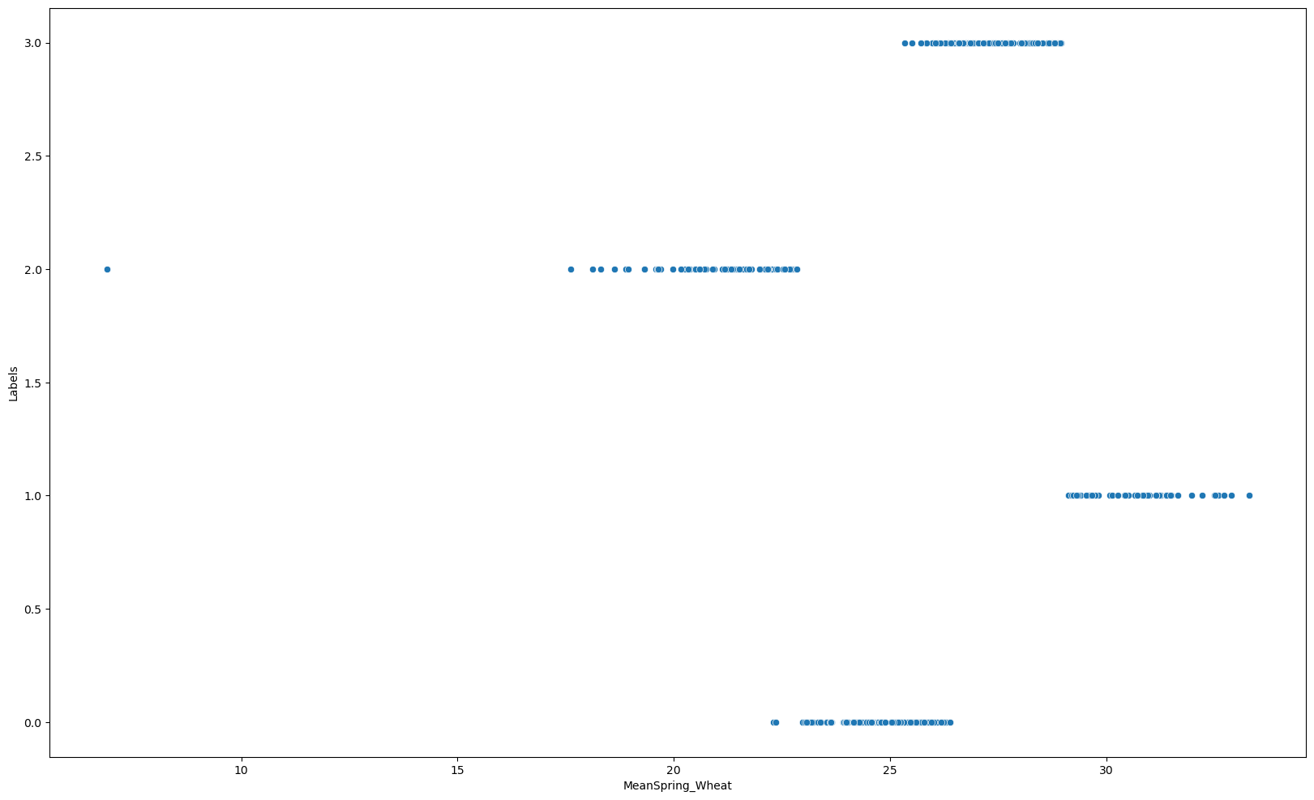
Scatter plot for SK 622 RMs(each clusters)

Slide 25
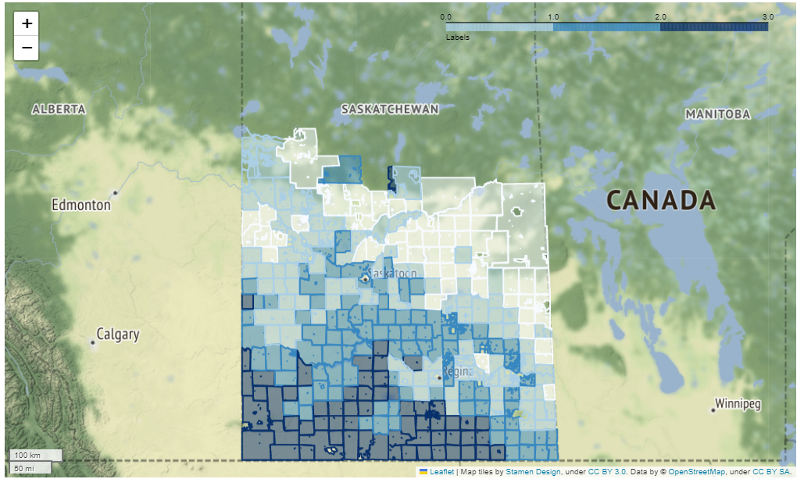
Define the features to be used for clustering

Slide 26
results
The sizes of the four clusters are as follows: 0: n = 27.34, 1: n = 20.87; 2: n = 30.66, 3: n = 24.54. The majority of the RMs in the south are in Cluster 3. According to the unsupervised ML, the highest value is in cluster 2.In the north SK, there is an exceptional RM, which also indicates that it belongs to class 3.However, spring wheat's high production is demonstrated in South Saskechawan RMs.

Slide 27
Summery
This project is based on spring wheat data from RM 111 (Mapel Creek), Saskatchewan's most southern RM. I have implemented the most popular unsupervised clustering technique, called K-Means Clustering. I worked with 4 clusters and obtained 14.454352113048293 for Kmeans inertia.
1 out of 84 samples were correctly labeled. Accuracy score: 0.01
Also, create a geodata map with regular data with the same unique values.

Slide 28
THANK YOU

